Slide 1








OTT Recommendation Data Analysis

Slide 2


Team
Venkat Sir

Slide 3


Contents
Introduction
Architecture Diagram
Data Description
Data Cleaning
Analysis (Pyspark, SparkScala, Hive)
Power BI Data Visualization
Conclusion
Contents

Slide 4

Introduction
The COVID-19 pandemic accelerated the growth of the global OTT streaming market as lockdowns shifted consumer behavior from traditional TV to on-demand digital content. This change led to a surge in OTT subscriptions and viewership.
Key Drivers:
Pandemic Lockdowns: Increased demand for digital content.
Behavioral Shift: Preference for on-demand viewing.
Exclusive Content: Platforms like Netflix, Amazon Prime, and Hulu capitalized on original programming.
The OTT market grew rapidly from $104.11B in 2019 to $161.37B in 2020, reflecting a 55% CAGR.
Goal:
To understand and leverage the evolving trends and innovations reshaping the future of digital entertainment.

Slide 5







Objectives
To implement Spark DF’s and applied optimization techniques like caching and partitioning.
To transform them into Data Frames
To analyse the Data
To save an optimized output in HDFS/LFS
To make reports using Power BI

Slide 6

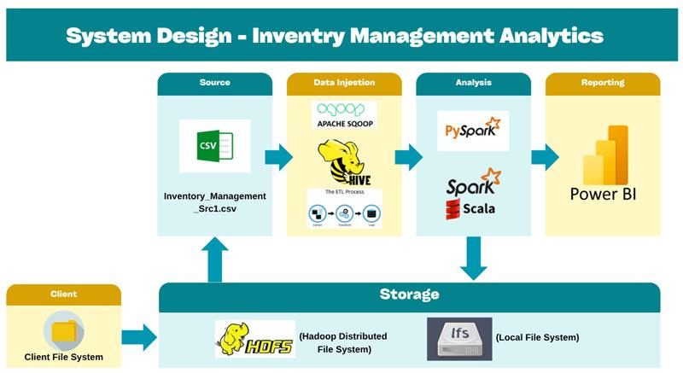


System Design
OTT Data Analysis
amazon prime movies.csv
netflix_titles.csv
disney_plus_shows.csv

Slide 7

amazon prime movies.csv
No. Of Rows :8128
Size : 2413Kb
Name Of Columns :
Movie Name
Language
IMDb Rating
Running Time
Year of Release
Maturity Rating
Plot
Data Description
Amazon Dataset

Slide 8
netflix_titles.csv
No. Of Rows :8808
Size : 3320Kb
Name Of Columns :
show_id
type
title
director
cast
country
date_added
release_year
rating
duration
listed_in
description
Data Description
Netflix Dataset

Slide 9
disney_plus_shows.csv
No. Of Rows :993
Size : 409Kb
Name Of Columns :
imdb_id runtime
genre director
title actors
plot country
language metascore
type awards
rated imdb_rating
year imdb_votes
released_at writer
added_at
Data Description
Disney Dataset

Slide 10

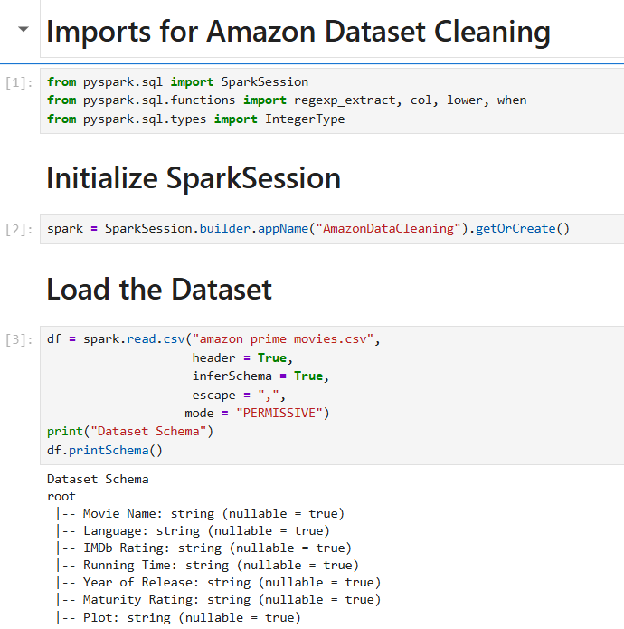
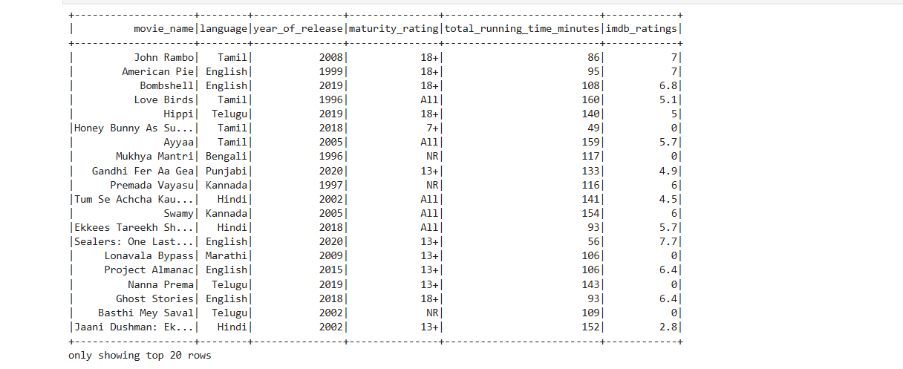

Amazon Dataset Cleaning
Imports for Amazon Dataset Cleaning
Initialize SparkSession
Load the Dataset

Slide 11
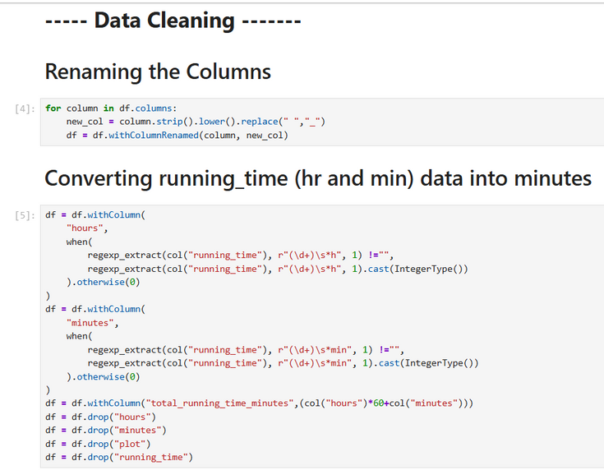
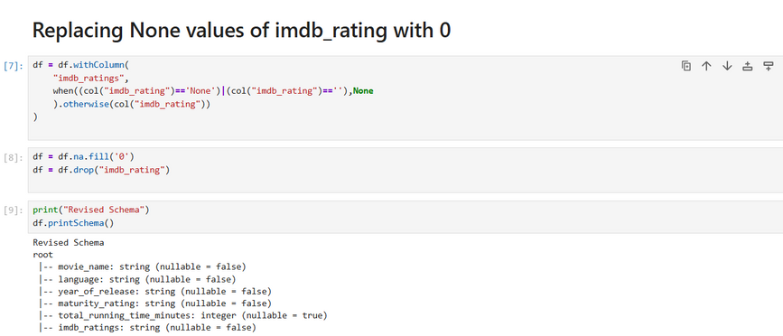
Amazon Dataset Cleaning
Renaming the Columns
Converting running_time (hr and min)
data into minutes
Replacing None values of imdb_rating with 0

Slide 12

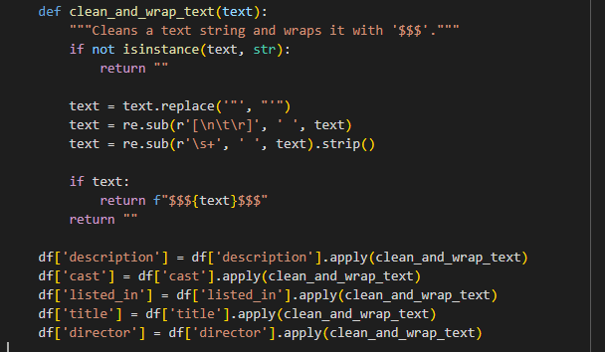
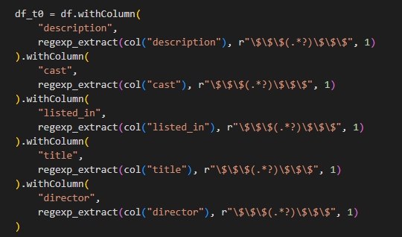
Netflix Dataset Cleaning
1. Complex Text Fields Causing Parsing Errors
The raw text contained special characters like newlines and unescaped quotes that broke the CSV structure, requiring a custom cleaning and wrapping process before loading into Spark.

Slide 13
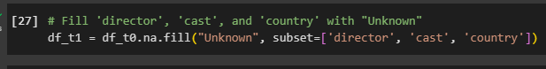
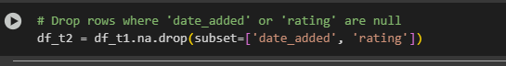
Netflix Dataset Cleaning
2. Missing Categorical Data
Columns like director, cast, and country had NULL values that were filled with the string "Unknown" to standardize the data for consistent filtering and grouping.
3. Missing Critical Data
Rows with missing date_added or rating information were dropped entirely to ensure the quality and integrity of the analytical dataset.

Slide 14
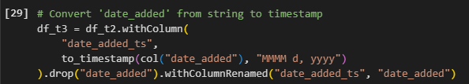
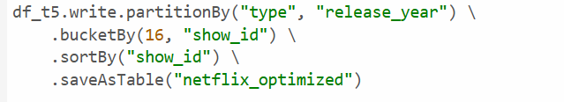

Netflix Dataset Cleaning
4. Incorrect Data Types
Columns like date_added and release_year were incorrectly loaded as strings and had to be converted to proper timestamp and integer types for analysis.
PySpark Storage Optimization
Partition by type, release_year for faster queries
Bucket by show_id (16 buckets) to reduce shuffle
Sort by show_id for quicker filters
Save as Hive table netflix_optimized
5. Duplicate Records
The dataset contained identical rows which were removed using dropDuplicates() to prevent inaccurate counts and skewed aggregations.

Slide 15
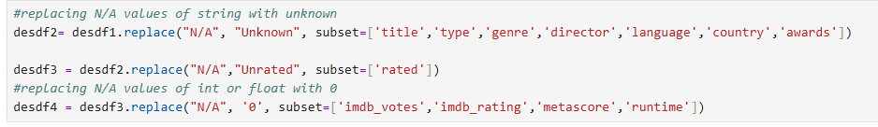
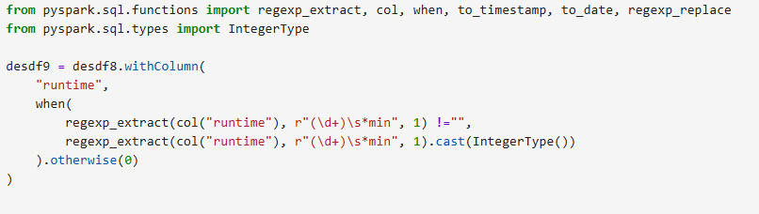
Disney Dataset Cleaning
Handled Missing Values: Replaced N/A in categorical columns with "Unknown" and in numerical columns with 0; dropped rows with critical missing data like date_added.
Corrected Data Types: Converted columns from string to proper integer, float, and date formats to enable calculations and time-based analysis.
Standardized Text: Cleaned and standardized inconsistent values (e.g., "UNRATED" to "Unrated") and special characters (commas, newlines) across text fields.

Slide 16
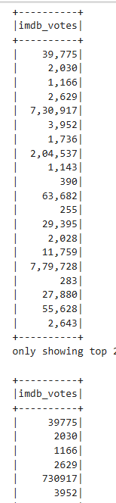
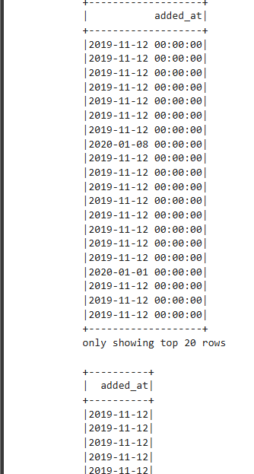
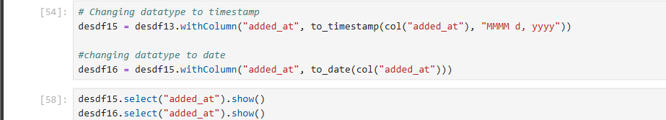
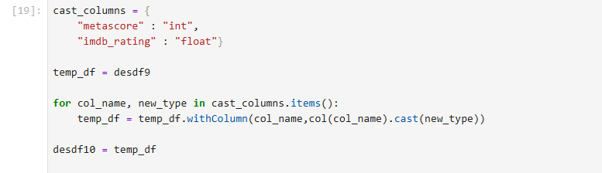
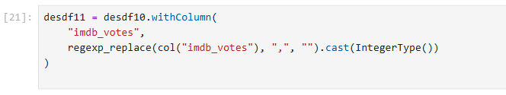
Disney Dataset Cleaning
Ensured Data Integrity: Removed irrelevant empty columns and eliminated duplicate records to ensure the accuracy of the final analysis.

Slide 17
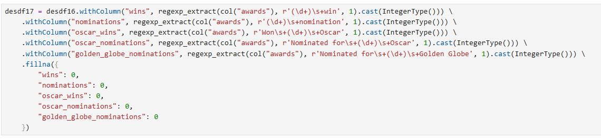
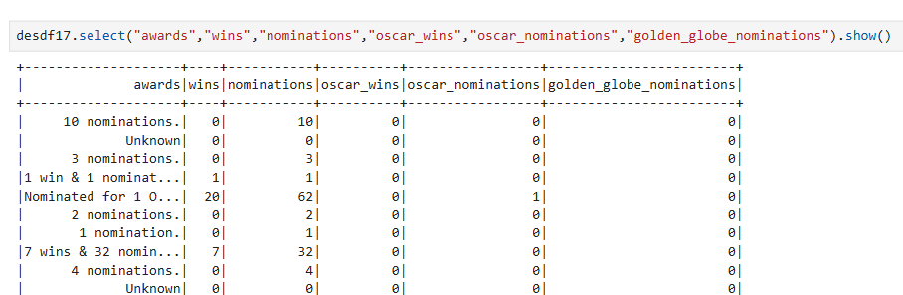
Disney Dataset Cleaning
Engineered New Features: Parsed the unstructured awards string to create new, structured numeric columns for wins, nominations, and oscar_wins.

Slide 18

Amazon Dataset
User Stories

Slide 19
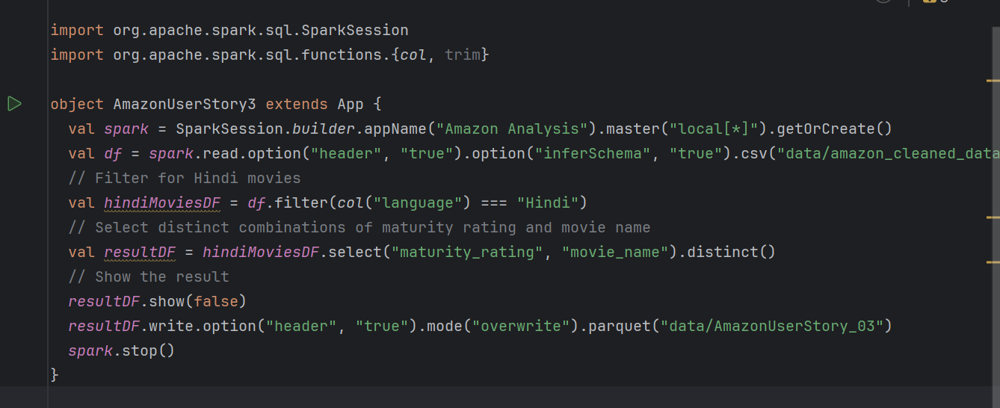
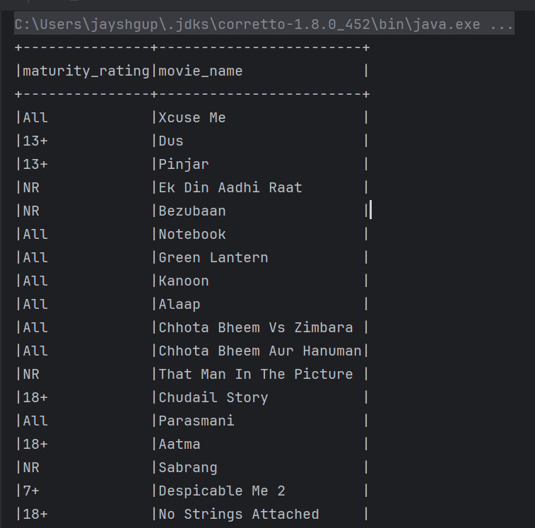
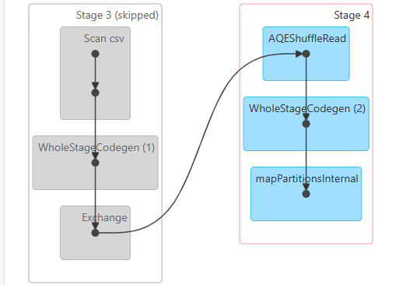
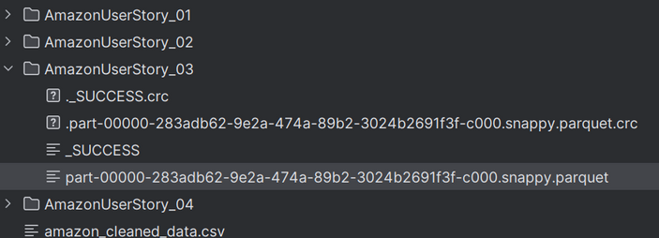
1. Which age group (maturity rating) is watching hindi movies? also, the movie titles(using SparkScala)

Slide 20
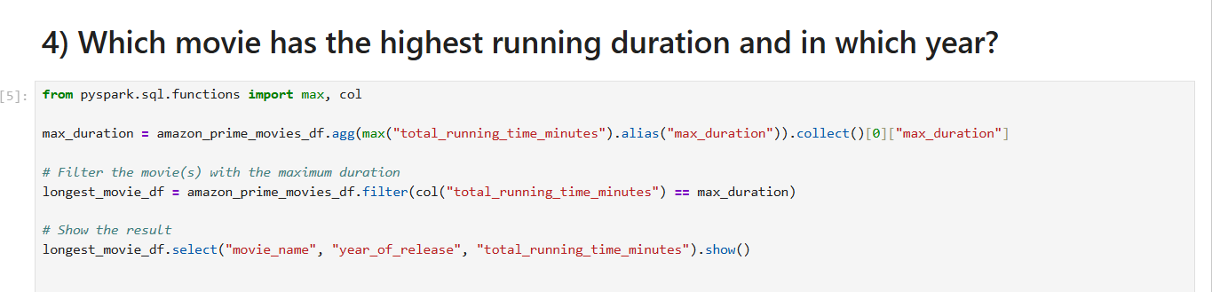
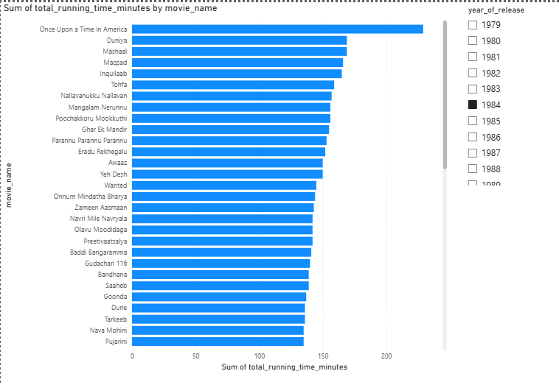
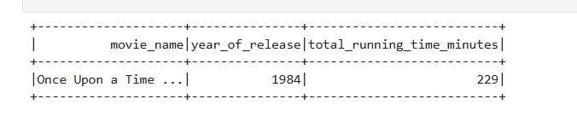
2. Which movie has the highest running duration and in which year?(using PySpark)

Slide 21
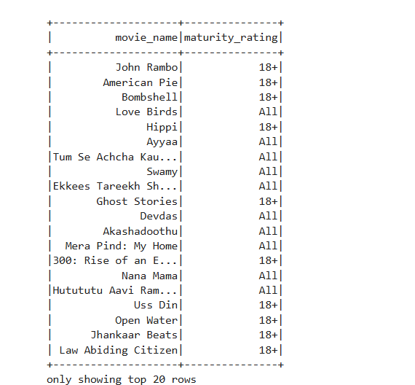
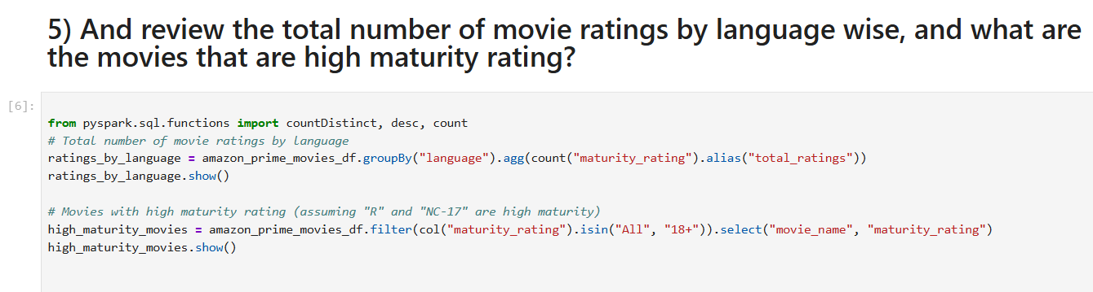
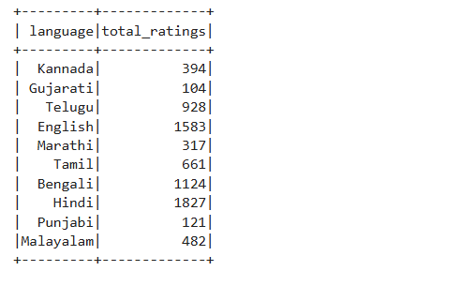
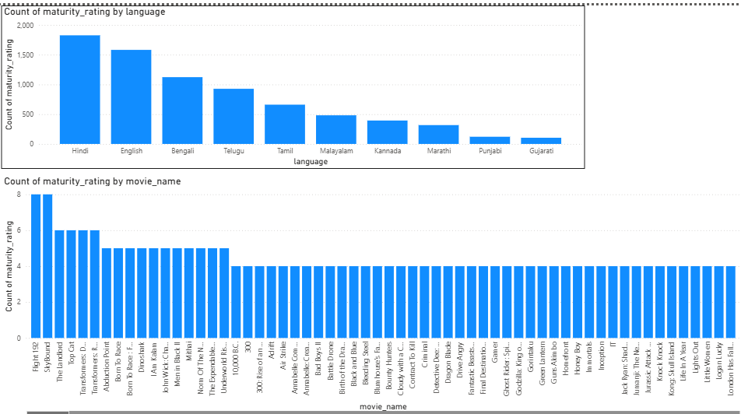
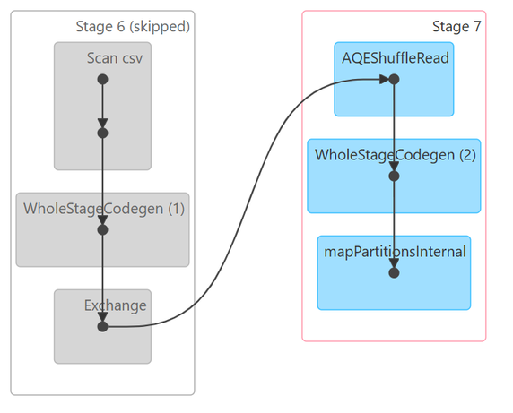
3. And review the total number of movie ratings by language wise, and what are the movies that are high maturity rating?(using Pyspark)

Slide 22

Netflix Dataset
User Stories

Slide 23
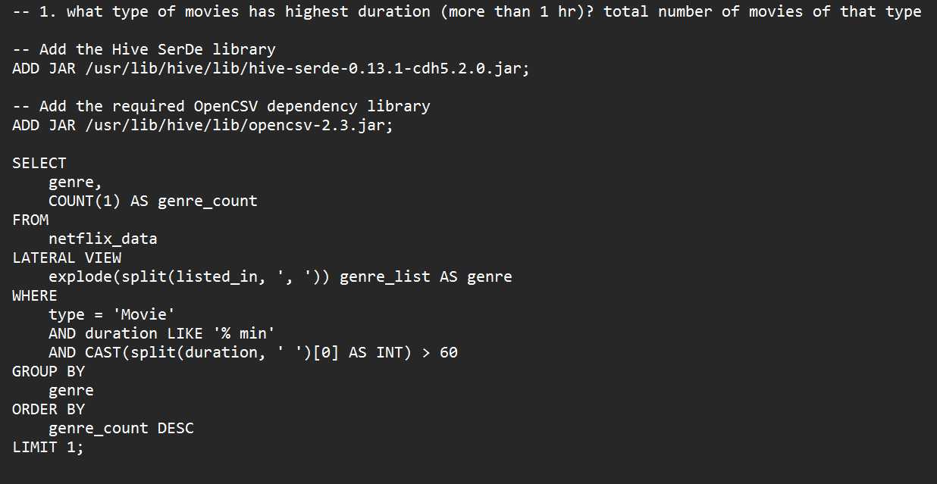
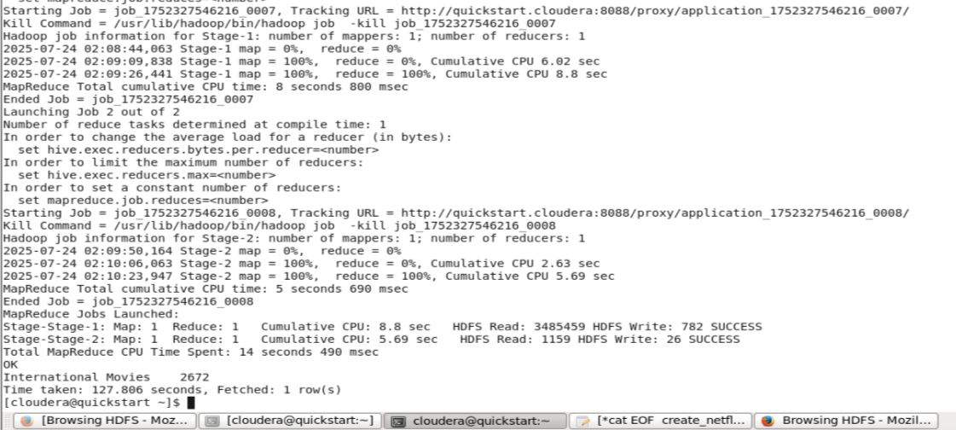
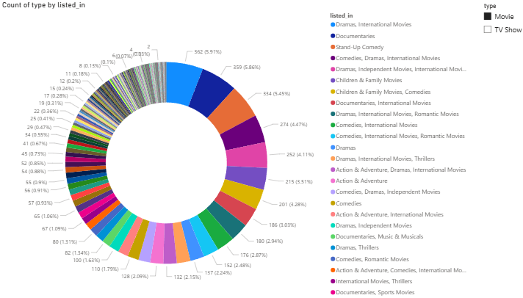
1. what type of movies has highest duration (more than 1 hr)? total number of movies of that type

Slide 24
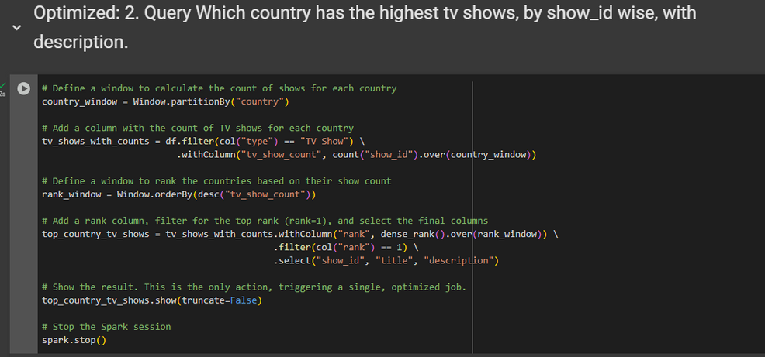
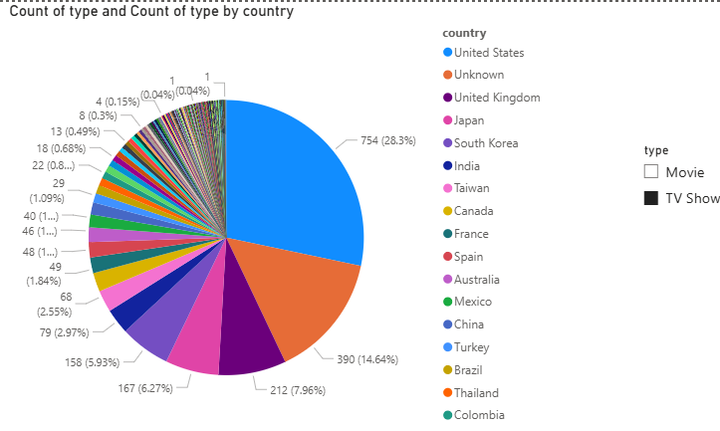
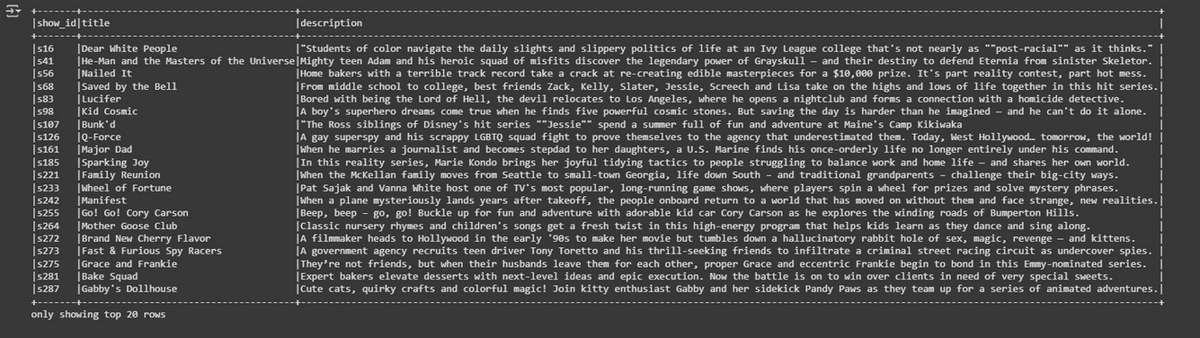
2. Which country has the highest tv shows, by show_id wise, with description.

Slide 25
Disney Dataset
User Stories

Slide 26
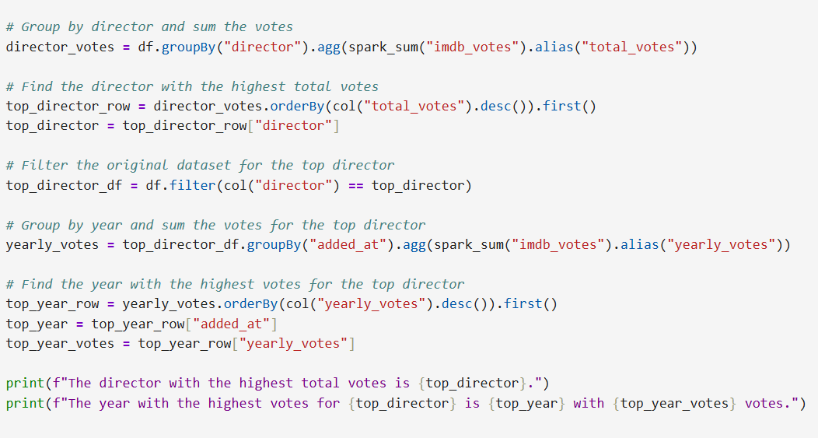

1. Which director's movies has the highest votes? and for that director, which year he has the highest votes? (Pyspark)

Slide 27
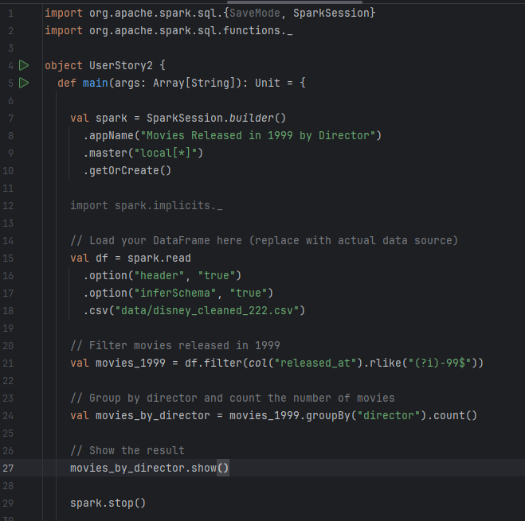
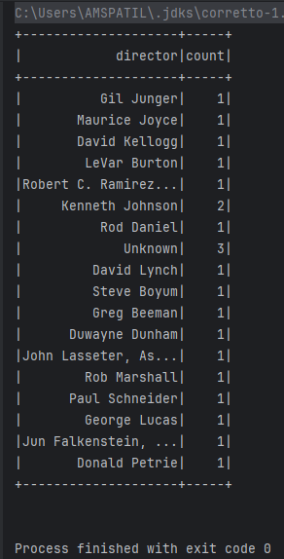
2. Total number of movies released in 1999, by director wise.
(Scala)

Slide 28
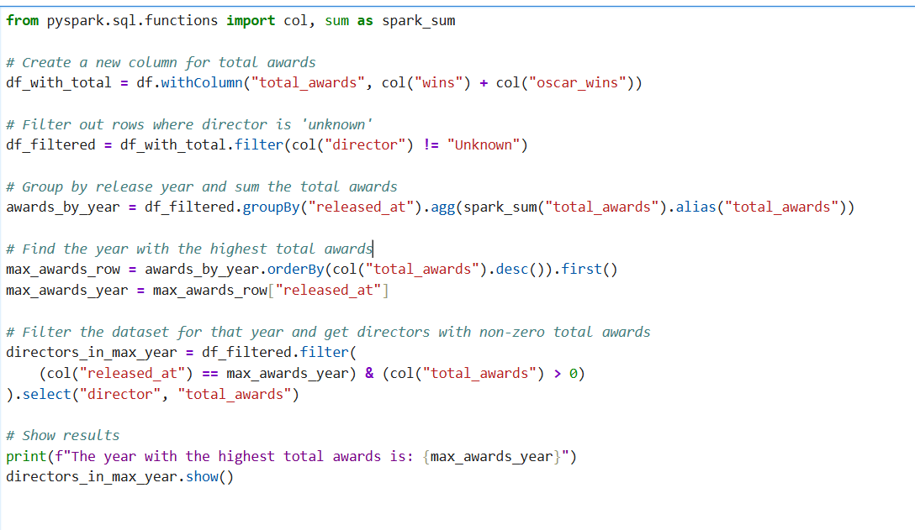
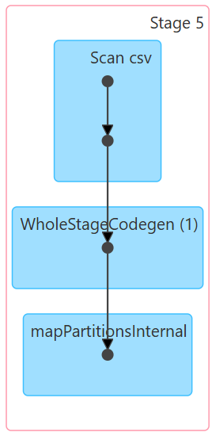
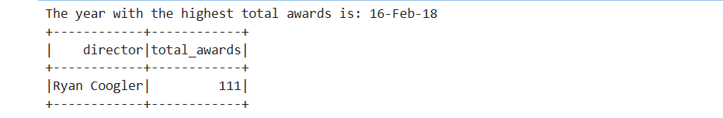
3. Which year movies got highest awards? And it belongs to which director?
(Pyspark)

Slide 29
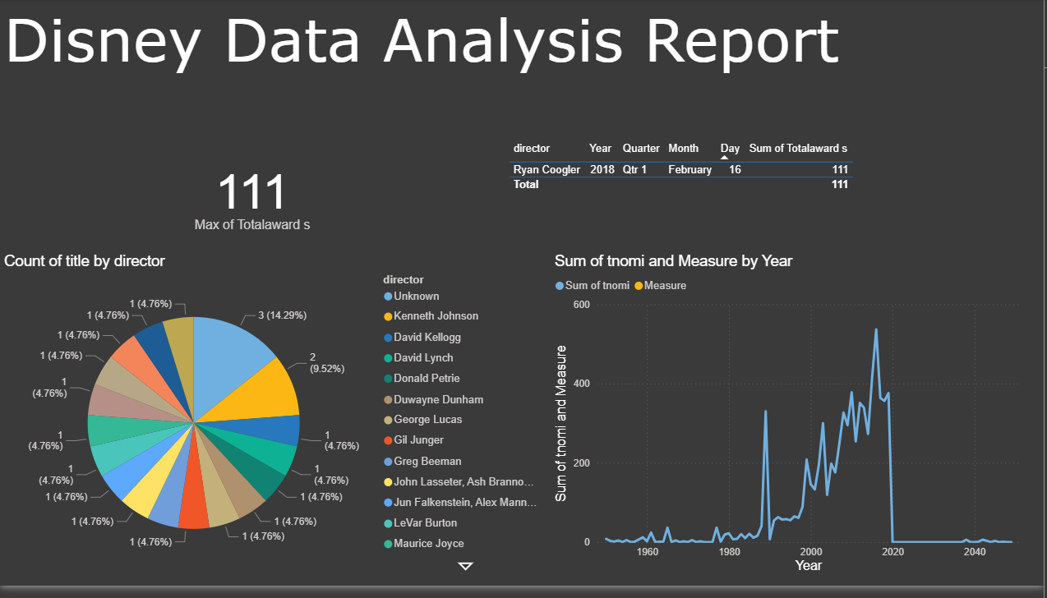

Slide 30
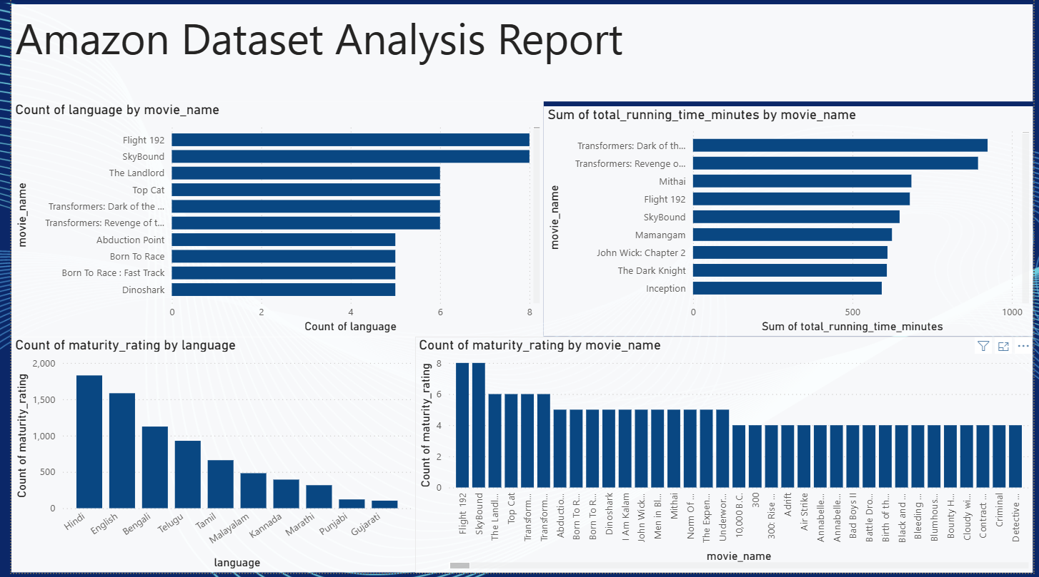

Slide 31


This project illustrates the efficiency of Apache Spark using both Scala and PySpark. It highlights scalable data processing, seamless transformations, and insightful analytics. Scala excels in performance and type safety, while PySpark offers usability and integration, making the duo effective for end-to-end big data solutions
Conclusion

Slide 32


Thank You Venkat Sir
Dear Venkat Sir,
Thank you for being such an inspiring mentor during our training. Your guidance, patience, and deep knowledge helped us grow both technically and personally. We’re truly grateful for the time and effort you invested in shaping our journey.

Slide 33

Any
Questions?

